Slide 1
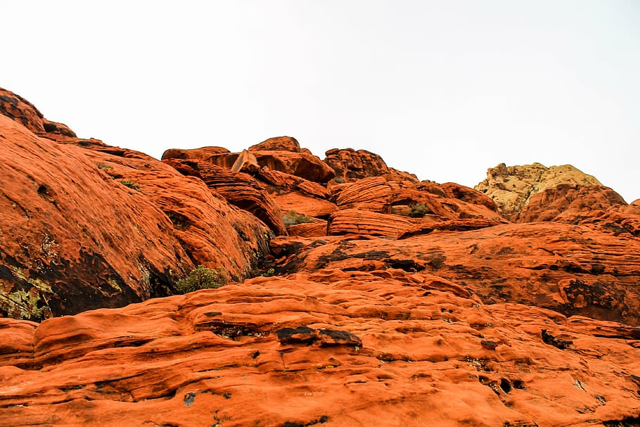
Predicting rock lithology using machine learning
Predicting rock lithology using machine learning
Presented by:
Ovie Iboyitie
Presented by:
Ovie Iboyitie
15th August, 2022

Slide 2


Outline
Problem Statement
What am I offering you
Methodology
Results
Conclusion
Limitations and References

Slide 3
Problem Statement
Obtaining a physical sample for determing the lithology of a rock is not always easy.
One has to be lucky enough to encounter parts of the desired reservoir below the free water level to predict rock lithology with high precision using well logs
The ratio of the compressional velocity to shear velocity is affected by formation anisotropy

Slide 4
What am I offering you?
A model developed using deep neural networks that predicts rock lithology but its;
Cost effective
Fast and optimizes time
Accurate and Precise

Slide 5

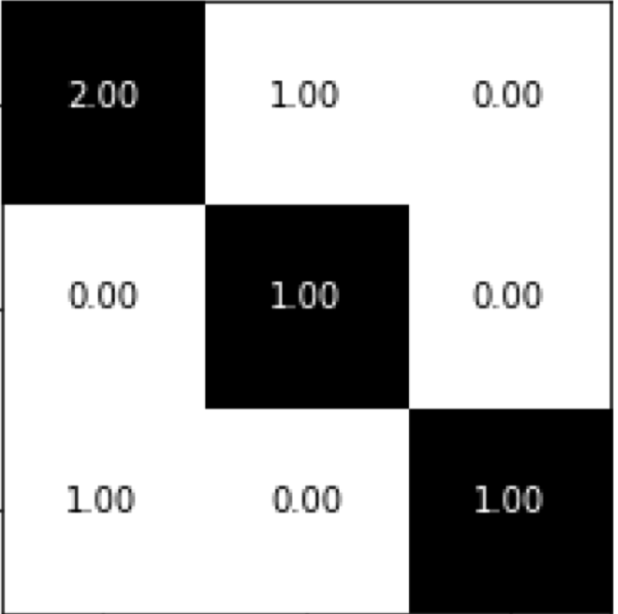


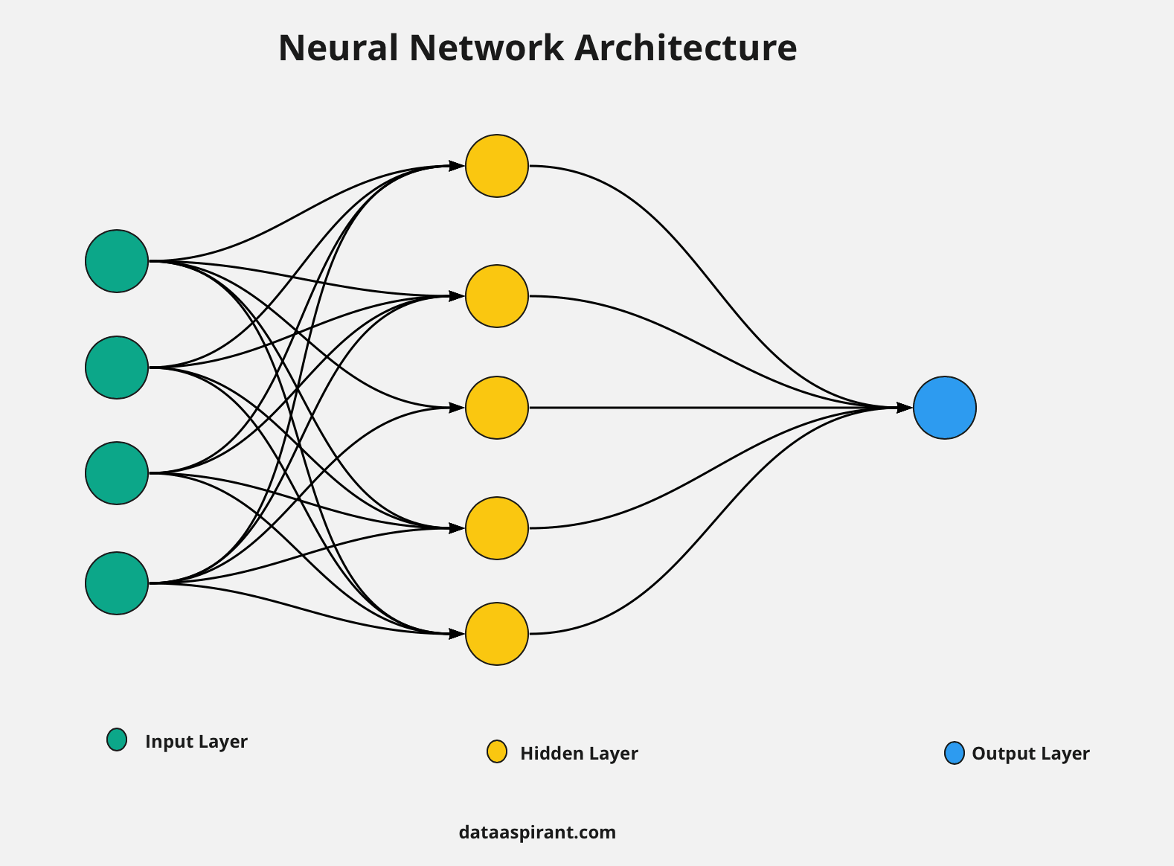
Methodology
F1 Score
Confusion Matrix
Accuracy
DATA WRANGLING AND EXPLORATORY DATA ANALYSIS
DATA COLLECTION
MODEL DEVELOPMENT
MODEL EVALUATION
Train/Test Split
Neural Network

Slide 6
Data Wrangling
Duplicates were removed.
Outliers were removed for density correction, gamma ray, neutron density, sonic (compressional slowness), and spontaneous potential logs.
Missing values were filled using an iterative imputer that predicts the missing value based on the values of the other columns for that observation

Slide 7
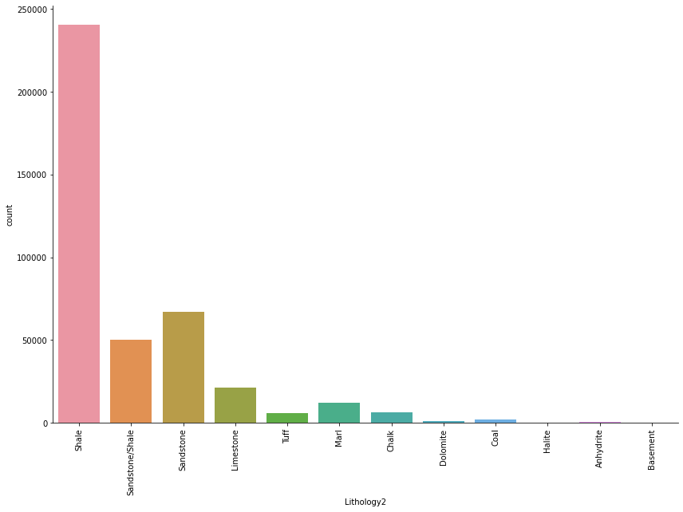
EDA with Data Visualization
Shale is the most occurred lithology in the dataset and classes like Basement, halite, Coal, Chalk, dolomite, Anhydrite, marl, Tuff and Limestone are largely underrepresented. Hence, The classes are imbalanced

Slide 8
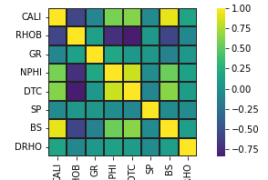
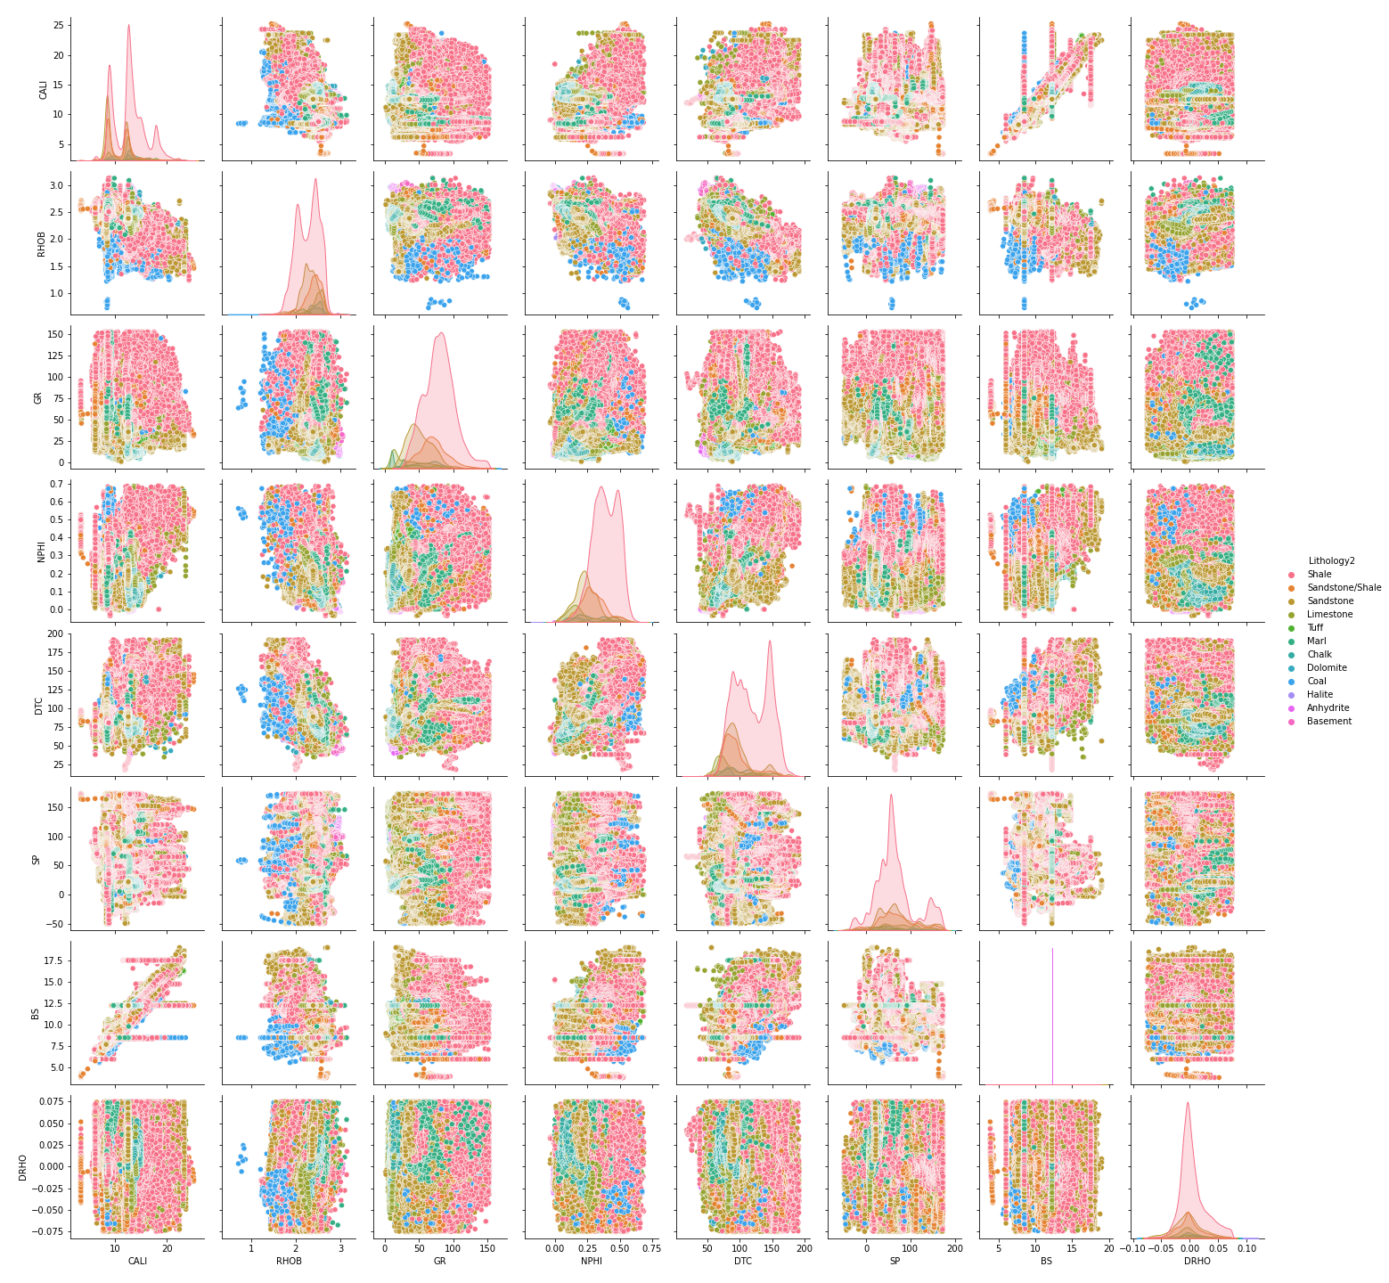
EDA with Data Visualization
Gamma Ray, Spontaneous potential, and density correction logs are the three most independent well logs. The pairplot shows the relationship between two variables and the different lithologies

Slide 9
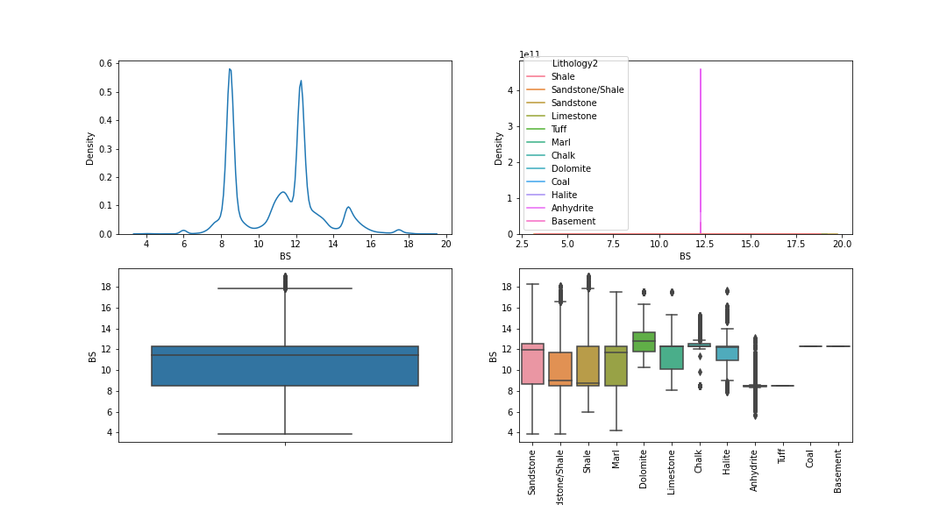
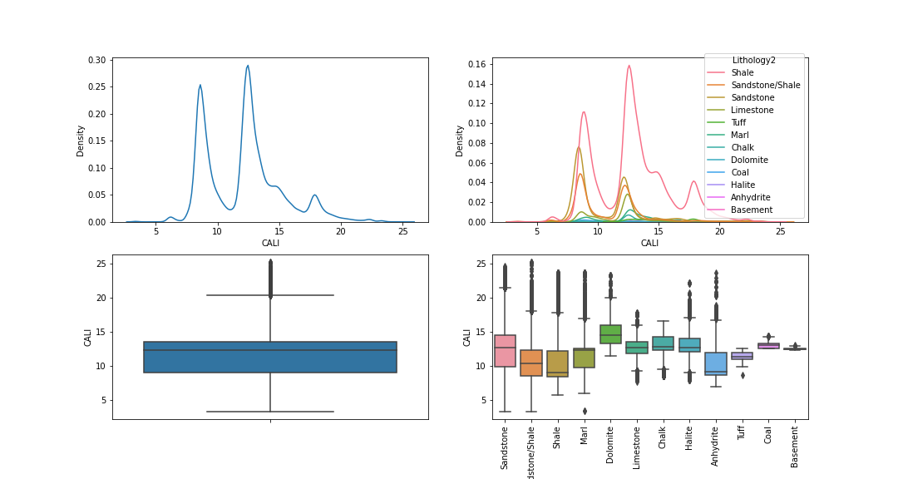
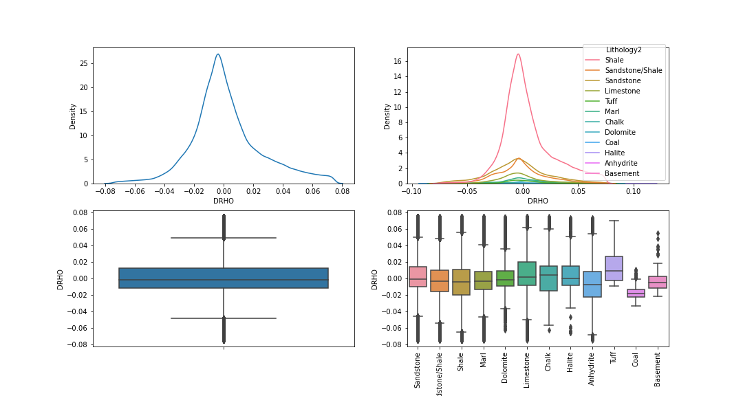
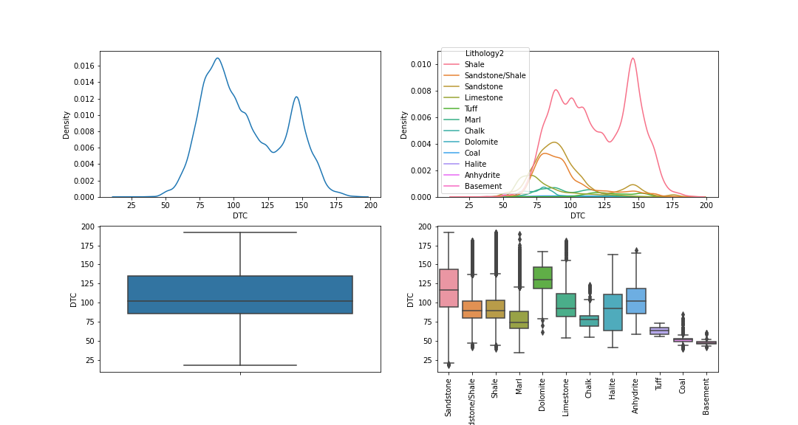
EDA with Data Visualization
1.
2.
3.
4.
BS
CALI
DRHO
DTC

Slide 10
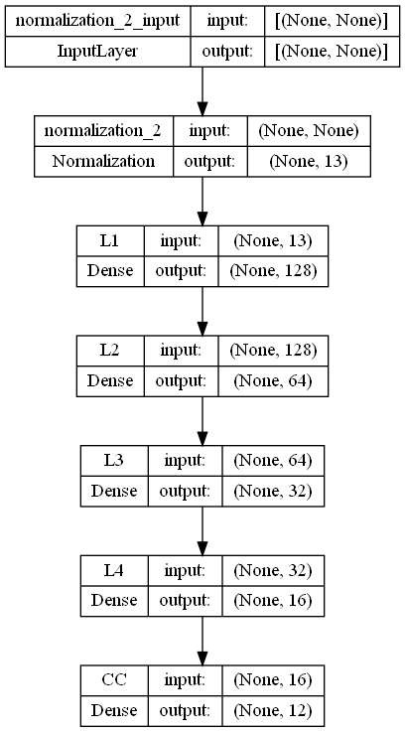
Model Architecture and Development
The Location (longitude and latitude), the depth, the NPD lithostratigraphy group, NPD lithostratigraphy formation, bulk density, raw gamma data, neutron density, sonic (compressional slowness), and spontaneous potential are used by the neural network to predict the lithology of the rock.
Model 3

Slide 11
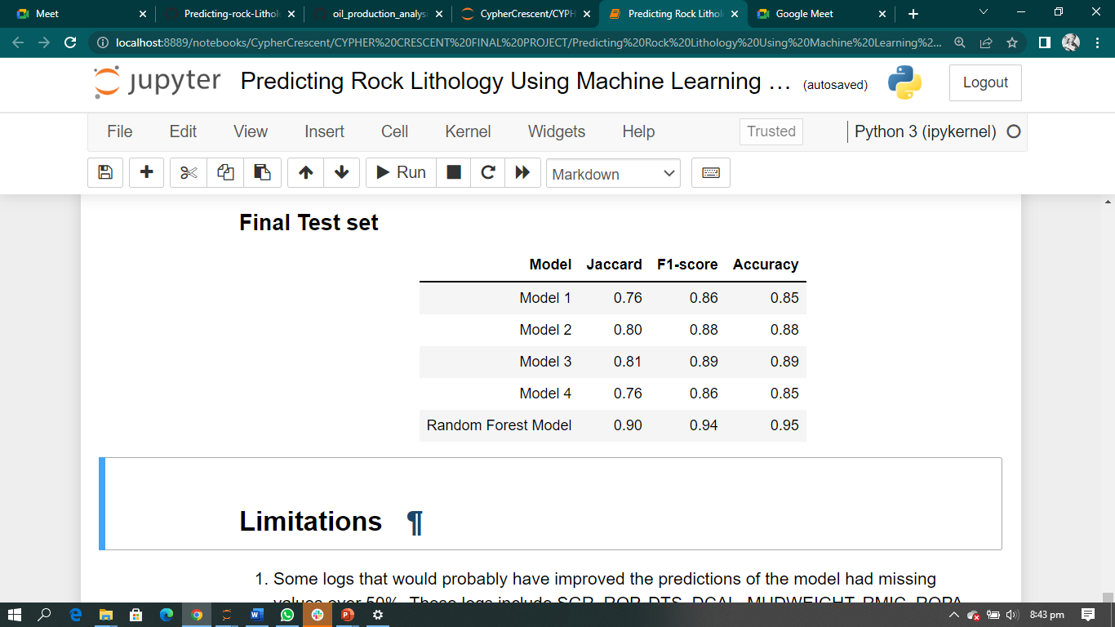
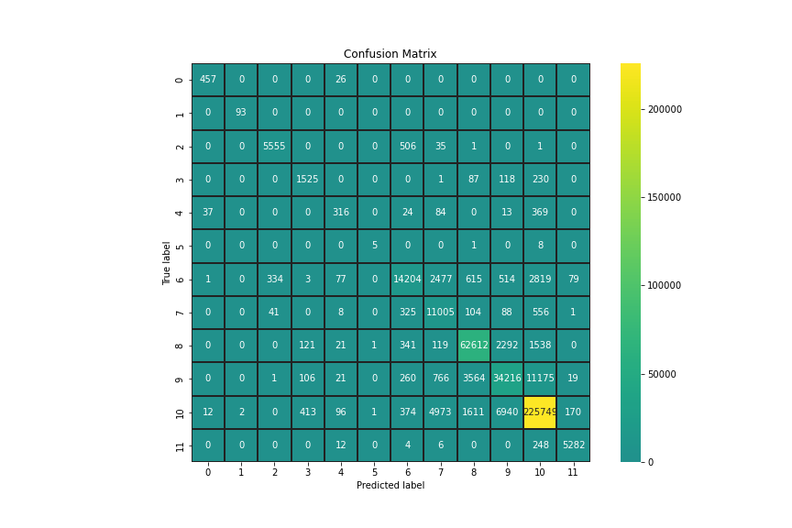
Model Evaluation
Four models were developed using artificial neural network. Model 3 did better in predicting the lithologies with an accuracy of 0.89.
The model does very well in predicting nine lithologies with high precision and recall. It performs poorly on in predicting dolomite and halite.

Slide 12
Conclusion
Using a deep neural network based on the multilayer perceptron, the rock lithologies were predicted, with accuracies of 89%. The model developed has a high recall and precision for predicting the other lithologies except for halite and dolomite and can be improved if more data are provided. This model eliminates the cost, need, and time of going subsurface to acquire samples to determine rock lithology.

Slide 13
Limitations and References
LIMITATIONS
1. Some logs that would probably have improved the predictions of the model had missing values over 50%. These logs include SGR, ROP, DTS, DCAL, MUDWEIGHT, RMIC, ROPA, RXO. Hence these logs were not used in training the model
2. Imbalanced classes. Anhydrite, Basement, Chalk, Coal, Dolomite, Halite, Limestone, Marl, and Tuff were underrepresented
REFERENCES
1. https://petrowiki.spe.org/Lithology_and_rock_type_determination
2. https:/github.com/bolgebrygg/Force-2020-Machine-Learning-competition/blob/c8d01ee92c1c8e1ecba36f96cca6ea7b689338a1/lithology_competition/data/train.zip

Slide 14
Thank you for listening

